Slide 1

Introduction to ASP.NET
DAY 1

Slide 2
In this session we will learn
What is ASP.NET?
What is a Web Application
What other technologies can be used to build web applications
What are the advantages of web applications
How ASP.NET web applications work
Using Visual Studio
Creating your first ASP.NET web application
Learn about different windows in visual studio

Slide 3
What is ASP.NET
ASP.NET is a Web application framework developed by Microsoft to build dynamic data driven Web applications and Web services.
ASP.NET is a subset of .NET framework. In simple terms a framework is a collection of classes.
ASP.NET is the successor to classic ASP (Active Server Pages).

Slide 4
What is a Web Application?
A web application is an application that is accessed by users using a web browser.
Examples of web browsers include
Microsoft Internet Explorer
Google Chrome
Mozilla FireFox
Apple Safari
Netscape Navigator

Slide 5
What other technologies can be used to build web applications
PHP
Java
CGI
Ruby on Rails
Perl

Slide 6
What are the advantages of Web applications?
Web Applications just need to be installed only on the web server, where as desktop applications need to be installed on every computer, where you want to access them.
Maintenance, support and patches are easier to provide.
Only a browser is required on the client machine to access a web application.
Accessible from anywhere, provided there is internet.
Cross Platform

Slide 7
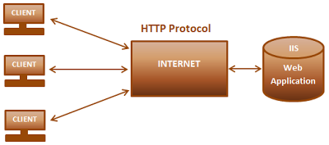
How Web applications work?
Web applications work on client/server architecture
On the client all you need is a browser, that can understand HTML
On the server side, the Web application runs under Microsoft Internet Information Services (IIS)

Slide 8
Visual Studio
When you first run visual studio, you will see the start page. The start page contains latest news related to .NET development, learning and community resources. If you are using visual studio 2013, at the bottom of the start page, you will notice the following 2 options.
Keep page open project loads - Select this option if you want to keep the start page, when you open and load a project.
Show page on startup - Uncheck this option, if you don't want the start page to be shown, when you start visual studio
If you have closed the start page, and later, if you want to see it again, select START PAGE from the VIEW menu.

Slide 9
Creating your first ASP.NET web application:
Select File => New Project
Select the Programming language you want to use from Installed > Templates section, in the New Project dialog box. Out of the box, you can either use C# or Visual Basic to develop ASP.NET web applications.
Now, Select ASP.NET Web Application, from the middle section of the New Project dialog box.
Give your project and solution a meaningful name.
Select the location, where you want the solution to be created.
Finally click OK.

Slide 10
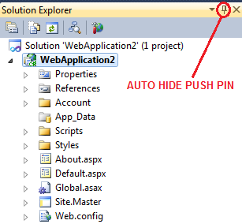
Different windows in visual studio:
Solution Explorer:
To view the solution explorer window, from the VIEW menu, select SOLUTION EXPLORER. Or you can also use keyboard short cut, CTRL + W, S. On the solution explorer, use the AUTO-HIDE push pin button, to either show or hide solution explorer.
Visual Studio organizes applications into projects and solutions. A solution is a collection of projects.
The solution file will have a .sln extension and the project file will have .csproj (if c# is the programming language) or .vbproj (if visual basic is the programming language)
STARTUP PROJECT is bolded. If you want to change your start up project, RIGHT CLICK the project, and select "SET AS STARTUP PROJECT".
The start-up project is the project that runs when you click Start in Visual Studio .NET.
When you’re developing multiple projects as part of a single solution, the start-up project usually calls the other projects in the solution.

Slide 11
Tool Box:
To view the TOOL BOX, Select TOOL BOX from the VIEW menu, or use the keyboard short cut, CTRL + W, X. Just like, solution explorer, tool box can be auto hidden using the AUTO-HIDE PUSH PIN. Toolbox displays the controls and components that can be used on a web form.
Properties Window:
Used to change property of a webform or a control on a webform. To view the Properties window, select PROPERTIES WINDOW from the VIEW menu, or use keyboard short cut CTRL + W, P.

Slide 12

Web Forms
WebForms has the extension of .aspx.
A web form also has a code behind and designer files. Code behind files has the extension of .aspx.cs (if c# is the programming language) or .aspx.vb (if vb is the programming language).
Designer files contains the extension of .aspx.designer.cs (if c# is the programming language) or .aspx.designer.vb (if visual basic is the programming language).
Code behind files contain the code that user writes, where as the designer file contains the auto generated code. You shouldn't change the code in the designer file, because that code might later be modified by Visual Studio and your changes could be overwritten.
A Web form is associated with its code file using the @Page directive found in the Web form’s HTML.

Slide 13
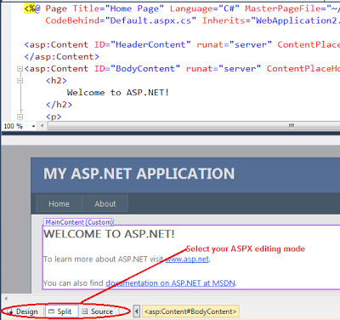
A webform's HTML can be edited either in Source or Design mode. You can also choose SPLIT mode, which shows both the DESIGN and the SOURCE at the same time.

Slide 14
Server Controls
DAY 4

Slide 15
ASP.NET TextBox Control
The TextBox control is used to get the input from the user of the web application. An asp.net textbox has several properties, that we need to be aware of as a developer.

Slide 16
Properties of a TextBox control
TextMode Propertry | SingleLine, MultiLine and Password. When you set the TextMode to MultiLine, use Rows property to control the number of lines to display for a MultiLine TextBox.
Text | Use this property to set or get the Text from the TextBox.
MaxLength | The maximum number of chatacters that a user can enter.
ReadOnly | Set this property to true if you don't want the user to change the text in the TextBox.
ToolTip | The tooltip is displayed when the mouse is over the control.
Columns | Use this property to specify the width of the TextBox in characters
AutoPostBack | By default, the TextChanged event of a TextBox control is cached in the viewstate, and is executed when the webform is submitted thru a postback by clicking the button control. If you want to change this behaviour, and post the webform immediately when the Text is changed, set AutoPostBack to true. Setting this property to true, will convert the cached event into a postback event.
Width | Set the width
Height | Set the height

Slide 17
Events of TextBox:
TextChanged | This event is fired, when the text is changed.
Methods of a TextBox:
Focus | Set input focus onto the control.

Slide 18
ASP.NET Radio Button Control
Radio Button control is used, when you want the user to select only one option from the available choices.

Slide 19
Properties of a Radio Button control
Checked | This is a boolean property, that is used to check if the button is checked or not.
Text | This is string property used to get or set the text associated with the radio button control
TextAlign | right or left. On which side of the radio button the text should appear
AutoPostBack | Set this property to true, if you want the webform to be posted immediately when the checked status of the radio button changes.
Group Name | By default, the individual radio button selections, are not mutually exclusive. If you have a group of radio buttons, and if you want the selections among the group to be mutually exclusive, then use the same group name for all the radio button controls.
Events of TextBox:
CheckedChanged | This event is fired when the checked status of the radio button control is changed.

Slide 20
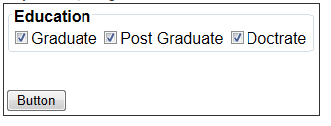
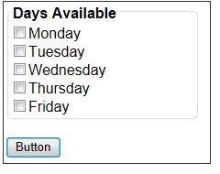
ASP.NET CheckBox Control
CheckBox Control is used, when you want the user to select more than one option from the available choices.

Slide 21
Properties of a CheckBox control
Checked | This is a boolean property, that is used to check if the check box is checked or not.
Text | This is a string property used to get or set the text associated with the check box control
TextAlign | right or left. On which side of the check box the text should appear
AutoPostBack | Set this property to true, if you want the webform to be posted immediately when the checked status of the check box changes.
Events of CheckBox
CheckedChanged | This event is fired when the checked status of the radio button control is changed.
Methods of a TextBox:
Focus | Set input focus onto the control.

Slide 22
ASP.NET Hyperlink control
The ASP.NET Hyperlink control is used to create a link to another Web page.

Slide 23
Properties of a Hyperlink control
Navigate URL | The URL of the page to which the user will be sent
Text | The link text that will be shown to the user
ImageURL | The URL of the image, that will be displayed for the link. If you specify both the Text and ImageUrl, the image will be displayed instead of the text. If for some reason, the image is not unavailable, the text will be displayed.
Target | If target is not specified, the web page to which the hyperlink is linked, will be displayed in the same window. If you set the Target to _blank, the web page will be opened in a new window.
Methods of Hyperlink:
Focus() | Call this method to Set the input focus when the page loads.

Slide 24
ASP.NET Button, LinkButton and ImageButton Controls
The Button, LinkButton and ImageButton controls in ASP.NET are used to post a page to the server.
1. Button - The Button control is used to display a push button. Use the Text property to change the Text on the Button control. 2. LinkButton - LinkButton displays the button like a HyperLink. Use the Text property to change the LinkText. 3. ImageButton - ImageButton provides the flexibility of associating an Image with the button, using the ImageURL property.

Slide 25


Client side click event and server side click event
All the 3 button controls, exposes client side click event and server side click event.
You can associate the javascript, that you want to run in response to the click event on the client side using OnClientClick property as shown below.

Slide 26
Application Life Cycle & Page Life Cycle
DAY 2

Slide 27
In this session we will learn about
What is a Web Server
Do you need IIS to develop and test asp.net web applications
How to check if IIS is installed?
Installing IIS
Configuring IIS server to run asp.net web applications
How the ASP.NET process a request
Application life cycle to take better control over the request and response.
Page life cycle to understand what need to be done when to serve the request in a proper manner.

Slide 28
What is a web server?
A web server is a software, that is used to deliver web pages to clients using the Hypertext Transfer Protocol (HTTP).
For example, IIS is a web server that can be used to run ASP.NET web applications.

Slide 29
Do you need IIS to develop and test asp.net web applications?
No, Visual Studio ships with a built-in web server. If you want to just build and test web applications on your machine, you don't need an IIS.
Built-in web server will not serve requests to another computer. By default, visual studio uses the built-in web server.

Slide 30
How to check if IIS is installed?
Click on the windows Start button
Type INETMGR in the Run window.
Click OK.
If you get IIS manager window, it is installed, otherwise not installed.

Slide 31
How to install IIS?
Click on the start button and select ControlPanel
Click on Programs
Click on, Turn windows features on or Off, under Programs and features option
In the windows features, Select Internet Information Services and related services, and click OK

Slide 32
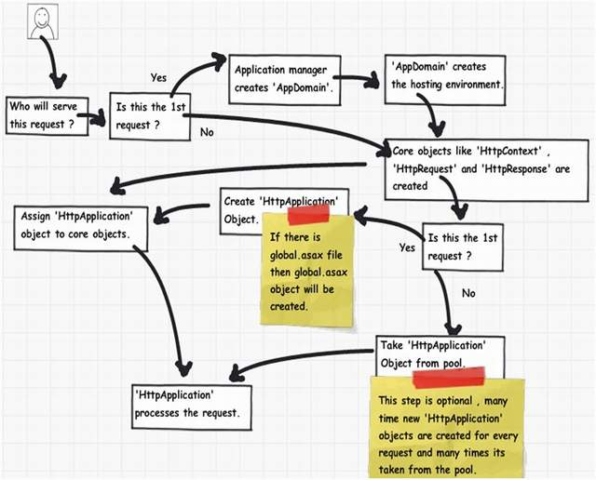
Application Life Cycle

Slide 33
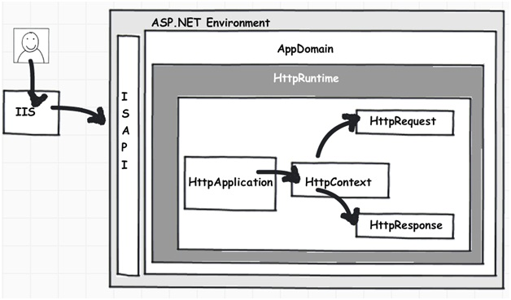
Object model for an ASP.NET request

Slide 34
Process Request using MHPM Events
Step 1(M: HttpModule):
Step 2 (H: ‘HttpHandler’):
Step 3 (P: ASP.NET page):
Step4 (M: HttpModule):

Slide 35
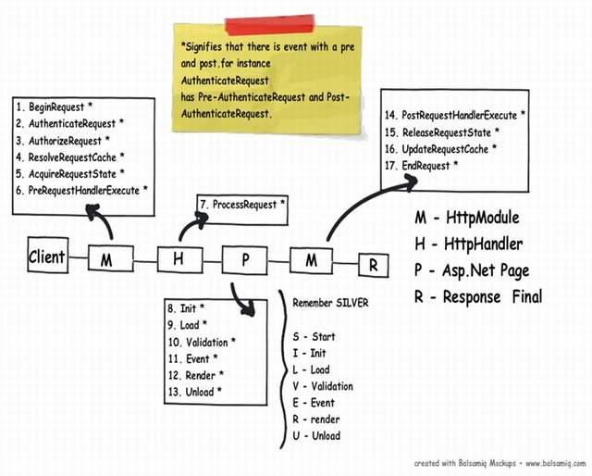

Slide 36
In What Event Should We Do What?
Section | Event | Description
HttpModule | BeginRequest | This event signals a new request; it is guaranteed to be raised on each request.
HttpModule | AuthenticateRequest | This event signals that ASP.NET runtime is ready to authenticate the user. Any authentication code can be injected here.
HttpModule | AuthorizeRequest | This event signals that ASP.NET runtime is ready to authorize the user. Any authorization code can be injected here.
HttpModule | ResolveRequestCache | In ASP.NET, we normally use outputcache directive to do caching. In this event, ASP.NET runtime determines if the page can be served from the cache rather than loading the patch from scratch. Any caching specific activity can be injected here.
HttpModule | AcquireRequestState | This event signals that ASP.NET runtime is ready to acquire session variables. Any processing you would like to do on session variables.
HttpModule | PreRequestHandlerExecute | This event is raised just prior to handling control to the HttpHandler. Before you want the control to be handed over to the handler any pre-processing you would like to do.

Slide 37
Section | Event | Description
HttpHandler | ProcessRequest | Httphandler logic is executed. In this section, we will write logic which needs to be executed as per page extensions.
Page | Init | This event happens in the ASP.NET page and can be used for:Creating controls dynamically, in case you have controls to be created on runtime. Any setting initialization. Master pages and the settings. In this section, we do not have access to viewstate, postedvalues and neither the controls are initialized.
Page | Load | In this section, the ASP.NET controls are fully loaded and you write UI manipulation logic or any other logic over here.
Page | Validate | If you have valuators on your page, you would like to check the same here.
 | Render | It’s now time to send the output to the browser. If you would like to make some changes to the final HTML which is going out to the browser, you can enter your HTML logic here.
Page | Unload | Page object is unloaded from the memory.

Slide 38
Section | Event | Description
HttpModule | PostRequestHandlerExecute | Any logic you would like to inject after the handlers are executed.
HttpModule | ReleaserequestState | If you would like to save update some state variables like session variables.
HttpModule | UpdateRequestCache | Before you end, if you want to update your cache.
HttpModule | EndRequest | This is the last stage before your output is sent to the client browser.

Slide 39
Events in a Web Application
DAY 3

Slide 40
Events
In a web application, events can occur at 3 levels
At the Application Level(Example: Application Start)
At the Page Level(Example: Page Load)
At the Control Level (Example: Button Click)

Slide 41
Application Level Events (Global.asax)
Global.asax file contains the 2 types of application level events.
Application events are used to initialize data that needs to be available to all the current sessions of the application.
Session events are used to initialize data that needs to be available only for a given individual session, but not between multiple sessions.

Slide 42
Example
Application_Start() event gets fired, when a first request is made, and if the application is not already running.
Session_Start() event is fired every time a new browser instance, with a different session-id, visits the application.
Session_End() event is fired when the user session times out. The default is 20 minutes. This can be configured in the web.config file.

Slide 43
Page Life Cycle
Web Application creates an instance of the requested webform.
Processes the events of the webform.
Generates the HTML, and sends the HTML back to the requested client.
The webform gets destroyed and removed from the memory.

Slide 44
ASP.NET Page Life Cycle Events
PreInit | As the name suggests, this event happens just before page initialization event starts. IsPostBack, IsCallback and IsCrossPagePostBack properties are set at this stage. This event allows us to set the master page and theme of a web application dynamically. PreInit is extensively used when working with dynamic controls.
Init | Page Init, event occurs after the Init event, of all the individual controls on the webform. Use this event to read or initialize control properties. The server controls are loaded and initialized from the Web form’s view state.
InitComplete | As the name says, this event gets raised immediately after page initialization.
PreLoad | Happens just before the Page Load event.
Load | Page Load event, occurs before the load event of all the individual controls on that webform.
Control Events | After the Page load event, the control events like button's click, dropdownlist's selected index changed events are raised.
Load Complete | This event is raised after the control events are handled.
PreRender | This event is raised just before the rendering stage of the page.
PreRenderComplete | Raised immediately after the PreRender event.
Unload | Raised for each control and then for the page. At this stage the page is, unloaded from memory.
Error | This event occurs only if there is an unhandled exception.

Slide 45
Validation controls
DAY 5

Slide 46
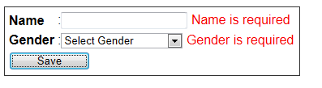
Validation controls
Validation controls are used to ensure if, the data, entered by the user is valid. Microsoft asp.net framework, provides 6 built-in validation controls.
RequiredFieldValidator
RangeValidator
RegularExpressionValidator
CompareValidator
CustomValidator
ValidationSummary

Slide 47
Client side and server side validation
Validation controls can be used to perform both client side and server side validation.

Slide 48
Display property is supported by all validation controls.
None - Error message not rendered and displayed next to the control. Used to show the error message only in the ValidationSummary control
Static - The error message is displayed next to the control if validation fails. Space is reserved on the page for the message even if validation succeeds. The span tag is rendered with style visibility:hidden
Dynamic - The error message is displayed next to the control if validation fails. Space is not reserved on the page for the message if the validation succeeds. The span tag is rendered with style display:none.

Slide 49
SetFocusOnError property is supported by all validation controls.
If this property is set to true, then the control will automatically receive focus, when the validation fails.

Slide 50
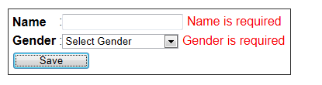
RequiredField validator control
This control, ensures that the required field is entered by the user.

Slide 51
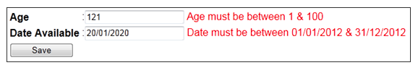
Rangevalidator control
This control is used to check if the value is within a specified range of values.
Properties specific to Rangevalidator control
Type - This property, specifies the data type of the value to check. Data types supported include - Currency, Date, Double, Integer, String.
MinimumValue - The minimum value allowed
MaximumValue - The maximum value allowed

Slide 52
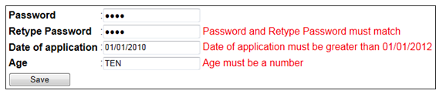
CompareValidator control
CompareValidator control is used to compare the value of one control with the value of another control or a constant value.
CompareValidator can also be used for DataType checking.
The comparison operation can be any of the following.
Equal
GreaterThan
GreaterThanEqual
LessThan
LessThanEqual
NotEqual
DataTypeCheck

Slide 53
Properties that are specific to the compare validator
ControlToCompare - The control with which to compare
Type - The DataType of the value to compare. String, Integer etc.
Operator - The comparison operator. Equal, NotEqual etc.
ValueToCompare - The constant value to compare with.

Slide 54
RegularExpressionValidator
This control is used to check if the value of an associated input control matches the pattern specified by a regular expression.
The only property that is specific to the RegularExpressionValidator is ValidationExpression.

Slide 55
CustomValidator control
CustomValidator control allows us to write a method with a custom logic to handle the validation of the value entered. If none of the other validation controls, serve our purpose, then the CustomValidator can be used.

Slide 56
ValidationSummary control
ValidationSummary control is used to display a summary of all validation errors occurred in a Web page, at one place.

Slide 57
ValidationGroups
If we don't use validation groups, then by default, whenever, you click a button, all the validation controls on the page get validated.

Slide 58
Page Navigation Techniques
DAY 6

Slide 59
Hyperlink control
The page you want to navigate to is specified by the NavigateURL property.

Slide 60
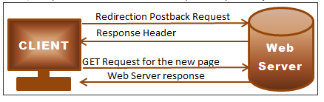
Response.Redirect
Response.Redirect causes 2 request/response cycles.
When Response.Redirect is used, the URL in the address bar changes and the browser history is maintained.
Response.Redirect() can be used to navigate pages/websites on the same web server or on a different web server.

Slide 61
Server.Transfer
Just like hyperlink and Response.Redirect, Server.Transfer is used to navigate to other pages/sites running on the same web server.
Server.Transfer cannot be used to navigate to sites/pages on a different web server.
Server.Transfer does not change the URL in the address bar
Server.Transfer is faster than Response.Redirect as the redirection happens on the server in one Request/Response cycle. Response.Redirect() involves 2 Request/Response cycles.
With Server.Transfer the Form Variables from the original request are preserved.

Slide 62
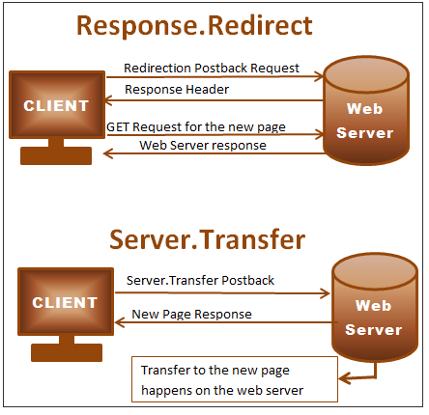
Differences between Server.Transfer and Response.Redirect

Slide 63
Server.Execute
Server.Transfer and Server.Execute are similar in many ways. 1. The URL in the browser remains the first page URL. 2. Server.Transfer and Server.Execute can only be used to navigate to sites/pages on the same web server. Trying to navigate to sites/pages on a different web server, causes runtime exception. 3. Server.Transfer and Server.Execute preserves the Form Variables from the original request.

Slide 64
Difference between Server.Transfer and Server.Execute
Server.Transfer terminates the execution of the current page and starts the execution of the new page, where as Server.Execute process the second Web form without leaving the first Web form.
After completing the execution of the first webform, the control returns to the second webform.

Slide 65
Cross page posting
Cross page posting allows to post one page to another page.
By default, when you click a button, the webform posts to itself.
If you want to post to another webform on a button click, set the PostBackUrl of the button, to the page that you want to post to.

Slide 66
Opening new window using javascript
Opening a new window using javascript method window.open().
window.open(URL, name, features, replace)

Slide 67
Techniques to send data from one webform to another
DAY 7

Slide 68
Techniques to send data from one webform to another
Cross Page Postback
Context.Handler object
Query strings
Cookies
Session state
Application state

Slide 69
Context.Handler object
When navigating between Web forms using the Transfer or Execute method, data can be retrieve from the previous Web form using Context.Handler object.

Slide 70
QueryString
Querystrings are name/value collection pairs
Using querystrings, is a very common way to send data from one webform to another.
Query strings are appended to the page URL.
?(Question Mark), indicates the beginning of a query string and it's value.
It is possible to use more than one query string. The first query string is specified using the ?(question mark). Subsequent query strings can be appended to the URL using the &(ampersand) symbol.
There is a limit on the Query string length. Hence, Query strings cannot be used to send very long data.
Query strings are visible to the user, hence should not be used to send sensitive information, unless encrypted.
To read the query string value, use Request object's QueryString property.
&(ampersand) is used to concatenate query strings, so if you want to send &, as value for the query string there are 2 ways, as shown below

Slide 71
Cookies
Cookies store small amounts of information on the client’s machine.
Cookies can be broadly classified into 2 types
Persistent cookies - Remain on the client computer, even after the browser is closed. You can configure how long the cookies remain using the expires property of the HttpCookie object.
Non-Persistent cookies - If you don't set the Expires property, then the cookie is called as a Non-Persistent cookie. Non-Persistent cookies only remain in memory until the browser is closed.

Slide 72
Session state
Session state variables are stored on the web server by default, and are kept for the life time of a session.
The default session state mode is InProc. We will discuss about different session state modes in a later video session.
The life time of a session is determined by the timeout value in web.config file. The default is 20 minutes. The time-out value can be adjusted according, to your application requirements. <sessionState mode="InProc" timeout="30"></sessionState>
Session state variables are available across all pages, but only for a given single session. Session variables are like single-user global data.
It is always a good practice to check, if a session state variable is null before calling any of its methods, such as ToString(). Otherwise, we may run into runtime NullReferenceExceptions.
Application performance can be improved by disabling session state, if it's not required. Session state can be turned off at the page or application level.

Slide 73
Application state
Application State variables are available across all pages and across all sessions. Application State variables are like multi-user global data.
Application State variables are stored on the web server.
Application State variables are cleared, only when the process hosting the application is restarted, that is when the application ends.
Application State variables are not shared across a Web Farm or a Web Garden.
Application state variables are not thread safe. Lock and Unlock methods of the application class must be used to protect against race conditions, deadlocks, and access violations. Application.Lock(); Application["GlobalVariable"] = (int)Application["GlobalVariable"] + 1; Application.UnLock(); Please Note: In this example, we are using application state variables to send data from one web form to another. If the requirement, is just to send data from webform to another, you should consider other alternatives.
Use application state variables only, when the variables need to have global access and when you need them for entire time, during the life time of an application. Cache object, can be used, as an alternative, if you need to have global access for a certain duration.

Slide 74
Exception handling
DAY 8

Slide 75
Exceptions
Exceptions are unforeseen errors that happen within the logic of an application.
When an exception occurs and if it is not handled, then, that exception is called as an, unhandled exception.

Slide 76
Exception handling using try-catch
Handling exceptions using try/catch blocks is commonly termed as structured exception handling.
try - Wrap the code in a try block that could possibly cause an exception. If a statement in the try block causes an exception, the control will be immediately transferred to the catch block.
catch - catches the exception and tries to correct the error and/or handles the exception
finally - Used to free resources. Finally block is guaranteed to execute irrespective of whether an exception has occurred or not
throw - used to raise an exception

Slide 77
Exception class
The base class for all exceptions is the Exception class. Specific exceptions should be caught, before catching the general parent exception.c

Slide 78
Error events
Asp.net provide 2 error events
Page_Error - This event is raised at the page level, when there is an unhandled exception on the page. The event handler resides on the page.
Application_Error - This event is raised at the application level, when there is an unhandled exception at an application level. The event handler resides in Global.asax file

